Slide 1
CMN130 Introduction to Journalism
Week 4
A word’s worth

Slide 2
Introduction – this lecture will help you understand:
Writing and reading processes
The language of news
Use of tense when news writing
Sentence length
House style
Readability, and writing that “works”
The vital importance of accuracy

Slide 3
Journalistic Writing
If it is not exciting, important, or of note as information, no one will read it.
If no one reads it, you’re wasting your time.
MAKE PEOPLE WANT TO READ

Slide 4
Keys to journalistic writing
Clarity
Do not use two words when one will do
Never use a long word when a short one will do
Explain things in the same way you would want them explained to you
Avoid meaningless words: lot, got, nice, big, small, lovely

Slide 5
Also avoid
Long-winded explanations
Unnecessary adjectives
Clichés
Anything not vital to a story
Confusing technical details
Jargon including “police speak”
Complex or old-fashioned words
Tautologies

Slide 6
If you don’t understand it, don’t write it
If you do not understand complex material how can you summarise it?
If you do write something you do not understand yourself, what hope will the audience have?
Ask experts to explain complex ideas in simple language
If that means asking “silly questions” then ask them

Slide 7
The art of writing
Use nouns and adjectives with care
Every sentence needs a verb
What is a noun?
What is an adjective?
What is a verb?
Keep sentences to SVO

Slide 8
Know who you write for
Nearly all news is written at some point
It is always written for the audience
Journalists must understand who they write for:
where do they live?
what things appeal to them, what do not?
what issues concern them?
who is respected in the community and who is not?
what history underlies key issues?
who has vested interests?

Slide 9
Language of news
News writing is disciplined writing
It involves using exactly the right words to convey specific meanings
Words convey moods and feelings as well as facts
News writing is more than a text message or email, but less than a short story
Once mastered, it is an extremely valuable skill and never forgotten

Slide 10
House style
“...the proper application of sound news-writing style, or its absence, is the most noticeable difference between the work of a professional journalist and that of a would-be-if-they-could-be amateur” (The Daily Miracle 2006:148)

Slide 11
House style
Is a set of rules about punctuation, capital letters, spelling, names, numbers, titles, honorifics, dates, etc
Its use results in a familiar sense of certainty and predictability for readers
Does not stifle individuality or creativity
Varies between different outlets
Involves careful attention to detail

Slide 12
Style and tense
While radio and television news is usually written in the present tense, newspaper news reports are nearly always in the past tense
Most newspaper news happened “yesterday” by the time it is read. Past tense
Online news writing tends to be written in past present tense. It is reporting something that has occurred, but often it has happened today.

Slide 13
Tense
A man has been arrested today. (online tense)
A man was arrested yesterday. (newspaper tense)
A Brisbane neighbourhood has been placed in lockdown again as experts prepare to carry out more controlled explosions on material found at a vacant rental property. (Online – ABC homepage)
A 12-year-old was allegedly used as a “delivery boy” by a major drug operation which trafficked speed and marijuana. (Print – The Courier-Mail front page)

Slide 14
A word about quotations
Quotes are used to put experts/witnesses/people in a story
A direct quote can be paraphrased into an indirect quote
But the process is strictly one way – an indirect quote can NEVER be reworked into a direct quote
A direct quote must be exactly what was said

Slide 15
Direct Vs Indirect
“Quoting accurately is very, very important,” the tutor said.
(Direct quote with attribution)
The tutor said this was very important.
(Paraphrase or indirect quote)
Remember to use past tense when using said !!!!*****!!!!!

Slide 16
Readability and reading
Shorter sentences are usually easier to read than longer sentences
The same goes for paragraphs
BUT an article in which all sentences and all paragraphs are short becomes visually and mentally boring for readers
So vary sentence and paragraph lengths and visualise how your article will look when printed

Slide 17
Skier “tried to outrun avalanche”
A SKIER who was killed in an avalanche in the Snowy Mountains yesterday tried to ride the snow before being buried, police said. – 23
Tom Carr-Boyd, 22, from the Blue Mountains town of Wentworth Falls, was skiing near Charlotte's Pass when a collapsed segment of hardened snow known as an ice cornice gave way yesterday afternoon. – 32
Cooma Police Inspector Peter Rooney said the snow and ice slid out from underneath him. – 14
“He was seen to attempt to ride the snow and stay above the surface,” he said. – 16
“However, at some stage he has been engulfed by the large amount of snow and ice.” – 16

Slide 18
Police and emergency service crews were called to the scene shortly after 1.30pm. – 13
“We (police) were aware at that stage that a person had been engulfed by the snow and that a search had taken place by witnesses to no avail,” Insp Rooney said. – 31
An extensive search of the area followed and the skier's body was recovered about 5.45pm. - 15

Slide 19
Accuracy is everything
It is far better to publish a story written by a plodder that is true, than to publish one that has been written by a word magician but contains errors
Inaccurate journalism is ineffective journalism
It is also dangerous journalism

Slide 20
Accuracy is everything
Getting it wrong
Missing flight MH370
Vegemite

Slide 21
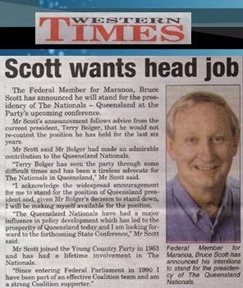
Think about the words you use!

Slide 22
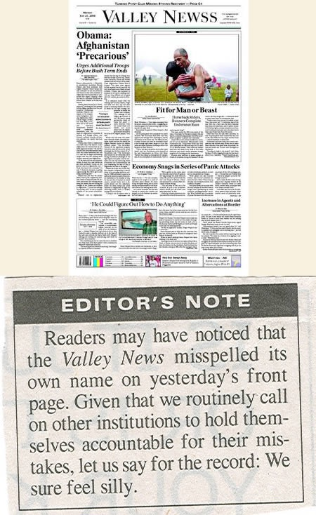
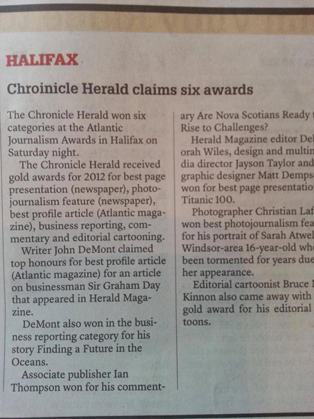
Accuracy is everything

Slide 23
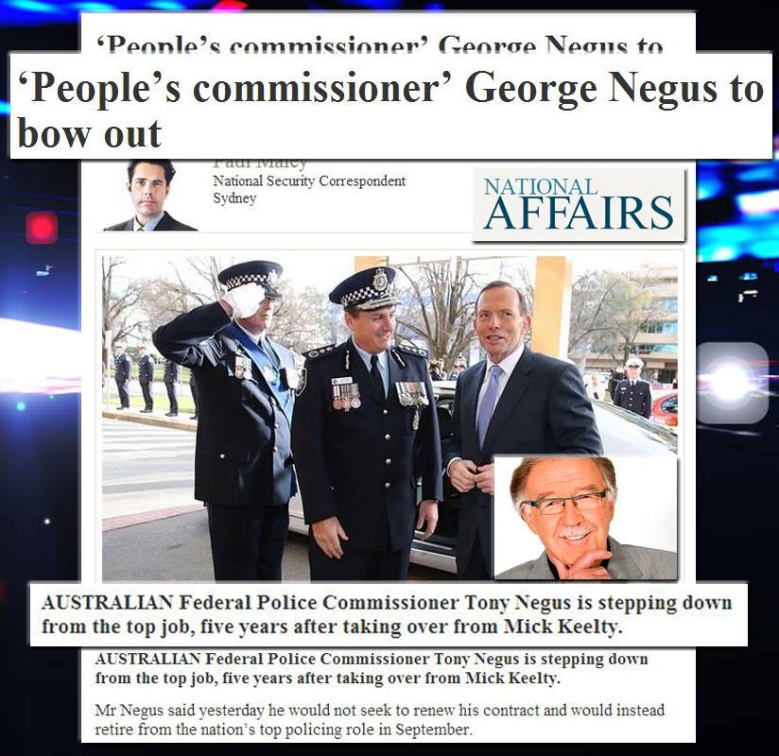
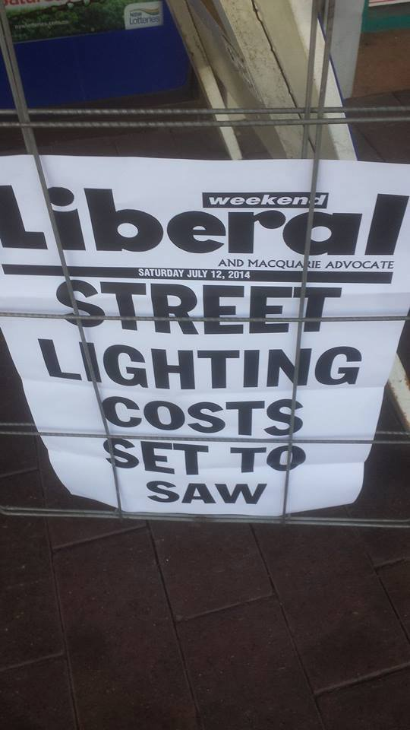

Slide 24
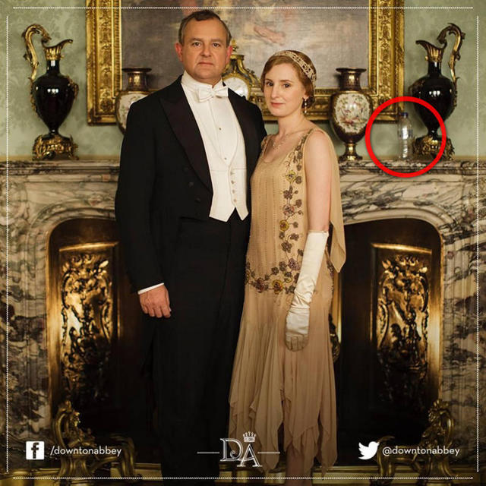
Accuracy is everything

Slide 25
Be extra careful with
Times and dates
Numbers
Addresses
Locations and place names
Titles of people and publications
Second-hand “facts”
Hearsay
NAMES

Slide 26
Protect yourself by being accurate
NEVER assume anything
Learn to distinguish between fact, opinion, speculation, and rumour
Double check key details such as the spelling of names, titles, and addresses
Become a bit paranoid – look for hidden agendas
Be careful with words – always select exactly the right one for the job

Slide 27
Reading….
Chapter 5 – The newsroom
Chapter 8 – Writing news for print

